Slide 1

The Art of Remembering
An Introduction to Memoïzation in Dynamic Programming

Slide 2
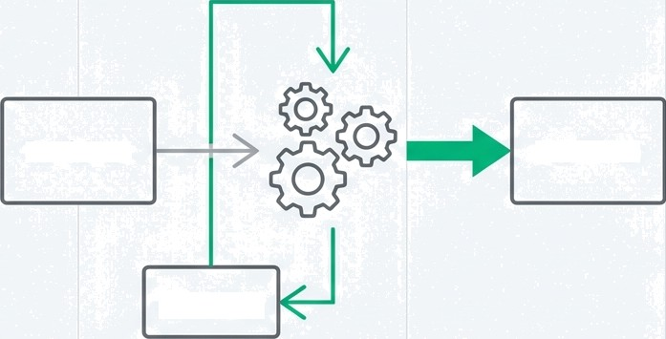
The core idea: efficiency through memory.
Problem
Solution
Dynamic Programming solves problems efficiently by remembering past results.
Memory
G NotebookLM

Slide 3
Let's consider a simple problem.
Imagine a computer is asked to calculate the following sum:
G NotebookLM

Slide 4




The Brute-Force Path:
Calculating from Scratch
Without memoization, each time the computer needs a sum, sum, like 1+1, it recalculates it from scratch.
+ 1) —• 2 —+ (2 + 1) —• 3 —• (3 + 1) —• 4 —• (4 + 1) —• 5

Slide 5









Portrait
Inefficiency
Repeated
calculation
Repeated calculation
'X I r’
› i \
Repeated
calculation
Repeated calculation

Slide 6




The Solution:
An Intelligent Memory
Memoization is the technique of storing the results of expensive function calls and returning the cached result when the same inputs occur again.
Input
Result
Function
Cache
G NotebookLM

Slide 7

The Intelligent Path: Calculate Once,
Remember Forever
For ”1 + 1 + 1 + 1 + 1 , the process changes.
Aher calculating 1 + 1 = 2”, the computer remembers '2’.
When '2 + 1‘ is needed, it simply uses the stored resutt.
STORE
RETRIEVE
—>[2] + 1 = 3
RETRIEVE
[3] + 1 = 4
RETRIEVE
[4] + 1 = 5
1 + 1 = 2
Cache
G NotebookLM

Slide 8

A Portrait of Efficiency
Cache

Slide 9



The Fundamental Trade-Off
“This technique “trades a little memory to store results
for a significant boost in processing speed.”’
Memory
Speed

Slide 10

The Essence of Dynamic
Programming
Dynamic Programming: The Strategy
This fundamental concept, trading memory for speed, is the essence of Dynamic Programming.
in Source Sans 3 Regular
Memoization:
The Tactic

Slide 11

A Skill for Optimising Algorithms
Understanding memoization is a crucial skill for any developer or student.

